Slide 1
Methods Of Data Collection, Organization And Presentation
Samuel D.[Samuel D.[Ass’t Prof/Epidemiology & Biostatistics, PhD in Epid fellow]

Slide 2
Methods of Data collection

Slide 3
Data Collection Methods
Data collection techniques allow us to systematically collect data about our objects of study (people, objects, and phenomena) and about the setting in which they occur.
In the collection of data we have to be systematic. If data are collected haphazardly, it will be difficult to answer our research questions in a conclusive way.

Slide 4
Various data collection techniques can be used such as:
Observation
Face-to-face and self-administered interviews
Postal or mail method and telephone interviews
Focus group discussions (FGD)

Slide 5
Reading assignment
Other data collection techniques
Rapid appraisal techniques,
3L technique,
Nominal group techniques,
Delphi techniques,
life histories, case studies, etc.

Slide 6
1. Observation
Observation is a technique that involves systematically selecting, watching and recoding behaviors of people or other phenomena and aspects of the setting in which they occur, for the purpose of getting (gaining) specified information.

Slide 7
Advantages:
Gives relatively more accurate data on behavior and activities.
Disadvantages:
Investigators or observer’s own biases, desires, and etc.
Needs more resources and skilled human power during the use of high level machines.

Slide 8
2. Interviews and self-administered questionnaire
Interviews and self-administered questionnaires are probably the most commonly used research data collection techniques.
Therefore, designing good “questioning tools” forms an important and time consuming phase in the development of most research proposals.

Slide 9
Once the decision has been made, Interviews may be less or more structured.
Unstructured interview
is flexible, the content wording and order of the questions vary from interview to interview.
The investigators only have idea of what they want to learn but do not decide in advance exactly what questions will be asked, or in what order.
are characteristic of qualitative (non-quantitative) research

Slide 10
Highly structured interview
in which the questions are asked orderly, or a self administered questionnaire, in which case the respondent reads the questions and fill in the answers by himself (sometimes in the presence of an interviewer who ‘stands by’ to give assistance if necessary).

Slide 11
The use of self-administered questionnaires is simpler and cheaper; such questionnaires can be administered to many persons simultaneously (e.g. to a class of students), and unlike interviews, can be sent by post.
On the other hand, they demand a certain level of education and skill on the part of the respondents.

Slide 12
In interviewing using questionnaire, the investigator appoints agents known as enumerators, who go to the respondents personally with the questionnaire, ask them the questions given there in, and record their replies.
They can be either face-to-face or telephone interviews.

Slide 13
Face-to-face and telephone interviews
A good interviewer can stimulate and maintain the respondent’s interest, and can create a rapport (understanding, concord) and atmosphere conducive to the answering of questions.
If anxiety aroused, the interviewer can allay it.
If a question is not understood an interviewer can repeat it and if necessary (and in accordance with guidelines decided in advance) provide an explanation or alternative wording.
apart from their expenses, interviews are preferable to self-administered questionnaire, with the important proviso that they are conducted by skilled interviewers.

Slide 14
Mailed Questionnaire Method:
The investigator prepares a questionnaire containing a number of questions pertaining the field of inquiry and sent by post to the informants together with
a polite covering letter explaining the detail,
the aims and objectives of collecting the information, and
requesting the respondents to cooperate by furnishing the correct replies and returning the questionnaire duly filled in.
The main problems with postal questionnaire are that response rates tend to be relatively low, and that there may be under representation of less literate subjects.

Slide 15
Use of documentary sources:
Clinical and other personal records, death certificates, published mortality statistics, census publications, etc.
Examples include:
Official publications of Central Statistical Authority
Publication of Ministry of Health and Other Ministries
News Papers and Journals.
International Publications like Publications by WHO, World Bank, UNICEF
Records of hospitals or any Health Institutions

Slide 16
Problems in gathering data:
Language barriers
Lack of adequate time
Expense
Inadequately trained and experienced staff
Invasion of privacy
Bias
Cultural norms (e.g. which may preclude men interviewing women)

Slide 17
Choosing a Method of Data Collection
Decision-makers need information that is relevant, timely, accurate and usable.
The cost of obtaining, processing and analyzing these data is high.
The challenge is to find ways, which lead to information that is cost-effective, relevant, timely and important for immediate use.
Some methods pay attention to timeliness and reduction in cost. Others pay attention to accuracy and the strength of the method in using scientific approaches.

Slide 18
The statistical data may be classified under two categories, depending upon the sources.
Primary data
Secondary data

Slide 19
Primary Data:
Collected by the investigator himself for the purpose of a specific inquiry or study.
Such data are original in character and are mostly generated by surveys conducted by individuals or research institutions.
The first hand information obtained by the investigator is more reliable and accurate since the investigator can extract the correct information by removing doubts, if any, in the minds of the respondents regarding certain questions.
High response rates might be obtained since the answers to various questions are obtained on the spot.

Slide 20
Secondary Data:
When an investigator uses data, which have already been collected by others, such data are called "Secondary Data".
can be obtained from journals, reports, government publications, publications of professionals and research organizations.
Secondary data are less expensive to collect both in money and time.

Slide 21
Types of Questions
Depending on how questions are asked and recorded we can distinguish two major possibilities –
Open –ended questions
closed questions.

Slide 22
Open-ended questions
Open-ended questions permit free responses that should be recorded in the respondent’s own words.
The respondent is not given any possible answers to choose from.
Such questions are useful to obtain information on:
Facts with which the researcher is not very familiar,
Opinions, attitudes, and suggestions of informants, or
Sensitive issues.

Slide 23
Closed Questions
Closed questions offer a list of possible options or answers from which the respondents must choose.
When designing closed questions one should try to:
Offer a list of options that are exhaustive and mutually exclusive
Keep the number of options as few as possible.
Closed questions are useful if the range of possible responses is known.

Slide 24
Requirements of questions
1. Must have face validity
That is the question that we design should be one that give an obviously valid and relevant measurement for the variable.
For example, it may be self-evident that records kept in an obstetrics ward will provide a more valid indication of birth weights than information obtained by questioning mothers.

Slide 25
2. Must be clear and unambiguous
The way in which questions are worded can ‘make or break’ a questionnaire. Questions must be clear and unambiguous.
They must be phrased in language that it is believed the respondent will understand, and that all respondents will understand in the same way.
To ensure clarity, each question should contain only one idea.

Slide 26
3. Must not be offensive
Whenever possible it is wise to avoid questions that may offend the respondent, for example those that deal with intimate matters, those which may seem to expose the respondent’s ignorance, and those requiring him to give a socially unacceptable answer.
4. The questions should be fair
They should not be phrased in a way that suggests a specific answer, and should not be loaded.
Short questions are generally regarded as preferable to long ones.

Slide 27
5. Sensitive questions
It may not be possible to avoid asking ‘sensitive’ questions that may offend respondents.
In such situations the interviewer (questioner) should do it very carefully and wisely.

Slide 28
Steps in designing questionnaire
Step1: Content
Take your objectives and variables as your starting point.
Decide what questions will be needed to measure or to define your variables and reach your objectives.
When developing the questionnaire, you should reconsider the variables you have chosen, and, if necessary, add, drop or change some.
You may even change some of your objectives at this stage.

Slide 29
Step 2: Formulating questions
Formulate one or more questions that will provide the information needed for each variable.
Take care that questions are specific and precise enough that different respondents do not interpret them differently.
The question, should be broken up into different parts and made so specific that all informants focus on the same thing.
Check whether each question measures one thing at a time.
Avoid leading questions.

Slide 30
Step 3: Sequencing of questions
Design your interview schedule or questionnaire to be “consumer friendly.”
At the beginning of the interview, keep questions concerning “background variables” (e.g., age, religion, education, marital status, or occupation) to a minimum.
Pose more sensitive questions as late as possible in the interview.
Use simple everyday language

Slide 31
Step 4: Formatting the questionnaire
When you finalize your questionnaire, be sure that:
Each questionnaire has a heading and space to insert the number, data and location of the interview, and, if required the name of the informant. You may add the name of the interviewer to facilitate quality control.
Layout is such that questions belonging together appear together visually. If the questionnaire is long, you may use subheadings for groups of questions.
Sufficient space is provided for answers to open-ended questions.

Slide 32
Step 5: Translation
If interview will be conducted in one or more local languages, the questionnaire has to be translated to standardize the way questions will be asked.
After having it translated you should have it retranslated into the original language.
You can then compare the two versions for differences and make a decision concerning the final phrasing of difficult concepts.

Slide 33
Method of data organization and presentation

Slide 34
Tabular presentation
A statistical table is an orderly and systematic presentation of numerical data in rows and columns. Rows (stubs) are horizontal and columns (captions) are vertical arrangements.
The use of tables for organizing data involves grouping the data into mutually exclusive categories of the variables and counting the number of occurrences (frequency) to each category.

Slide 35
Introduction cont…
These mutually exclusive categories, for qualitative variables, are naturally occurring groupings.
For example,
Sex (Male, Female),
Marital status (single, Married, divorced, widowed, etc.),
Blood group (A, B, AB, O),
Method of Delivery (Normal, forceps, Cesarean section, etc.), etc. are some qualitative variables with exclusive categories.

Slide 36
Introduction cont…
In the case of large size quantitative variables like weight, height, etc. measurements, the groups are formed by amalgamating continuous values into classes of intervals.
There are, however, variables which have frequently used standard classes.
One of such variables, which have wider applications in demographic surveys, is age.

Slide 37
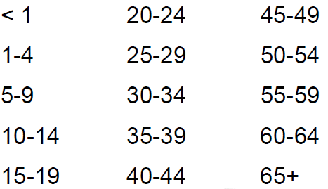
Introduction cont…
The age distribution of a population is described based on the following intervals:

Slide 38
Introduction cont…
Based on the purpose for which the table is designed and the complexity of the relationship, a table could be either of simple frequency table or cross tabulation.

Slide 39
Introduction cont…
The simple frequency table is used when the individual observations involve only to a single variable whereas the cross tabulation is used to obtain the frequency distribution of one variable by the subset of another variable.
In addition to the frequency counts, the relative frequency is used to clearly depict the distributional pattern of data.

Slide 40
Introduction cont…
It shows the percentages of a given frequency count.
For simple frequency distributions, the denominators for the percentages are the sum of all observed frequencies.
On the other hand, in cross tabulated frequency distributions where there are row and column totals, the decision for the denominator is based on the variable of interest to be compared over the subset of the other variable.

Slide 41
Construction of tables
Although there are no hard and fast rules to follow, the following general principles should be addressed in constructing tables.
Tables should be as simple as possible.
Tables should be self-explanatory.
If data are not original, their source should be given in a footnote.

Slide 42
Construction of Table cont…
For that Purpose:-
Title should be clear and to the point( a good title answers: what? when? where? how classified ?) and it be placed above the table.
Each row and column should be labelled.
Numerical entities of zero should be explicitly written rather than indicated by a dash. Dashed are reserved for missing or unobserved data.
Totals should be shown either in the top row and the first column or in the last row and last column.

Slide 43
Simple or one-way table
The simple frequency table is used when the individual observations involve only to a single variable whereas the cross tabulation is used to obtain the frequency distribution of one variable by the subset of another variable.
In addition to the frequency counts, the relative frequency is used to clearly depict the distributional pattern of data.
It shows the percentages of a given frequency count.

Slide 44
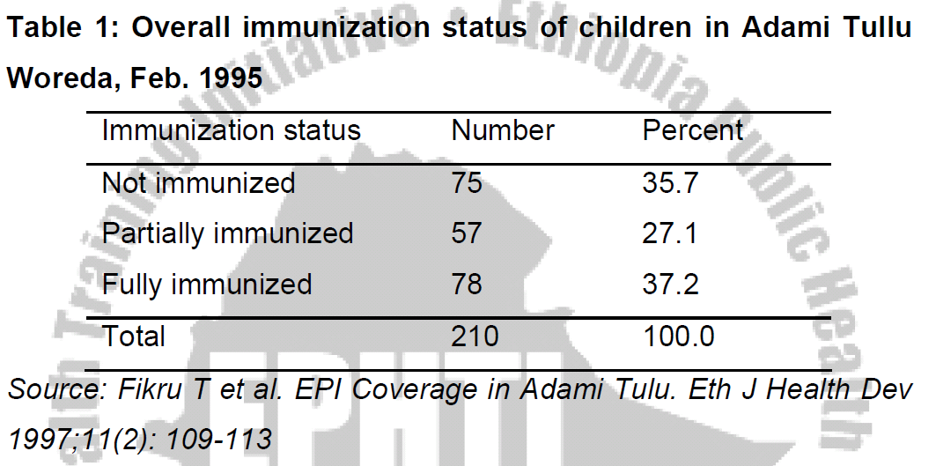

Slide 45
Two-way table
This table shows two characteristics and is formed when either the caption or the stub is divided into two or more parts.
In cross tabulated frequency distributions where there are row and column totals, the decision for the denominator is based on the variable of interest to be compared over the subset of the other variable.

Slide 46
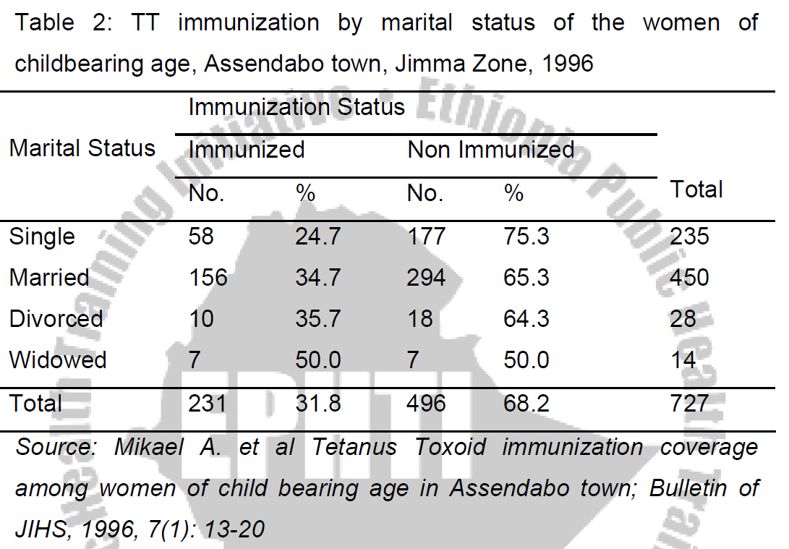

Slide 47
Higher Order Table
When it is desired to represent three or more characteristics in a single table.
Thus, if it is desired to represent the `Profession,' `sex' and `Residence,' of the study individuals, the table would take the form as shown in table 3 below and would be called higher order table.

Slide 48
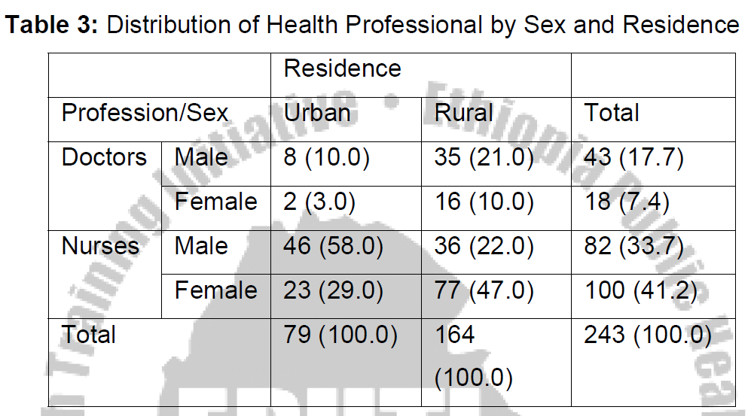

Slide 49
Frequency Distributions
A frequency is the number of times a given datum occurs in a data set.
A frequency distribution is a table that shows \classes" or \intervals" of data entries with a count of the number of entries in each class.

Slide 50
A categorical distribution
Non-numerical information can also be represented in a frequency distribution.
In connection with large sets of data, a good overall picture and sufficient information can often be conveyed by grouping the data into a number of class intervals.

Slide 51
A categorical distribution cont…
Example
This kind of frequency distribution is called grouped frequency distribution.
Age (years) | Number of persons
Under 18 | 1,748
18 – 24 | 3,325
25 – 34 | 3,149
35 – 44 | 1,323
45 – 54 | 512
55 and over | 335
Total | 10,392

Slide 52
A categorical distribution cont…
Frequency distributions present data in a relatively compact form, gives a good overall picture, and contain information that is adequate for many purposes, but there are usually some things which can be determined only from the original data.
For instance, the above grouped frequency distribution cannot tell how many of the arrested persons are 19 years old, or how many are over 62.

Slide 53
A categorical distribution cont…
The construction of grouped frequency distribution consists essentially of four steps:
Choosing the classes,
Sorting (or tallying) of the data into these classes,
Counting the number of items in each class, and
Displaying the results in the forma of a chart or table

Slide 54
A categorical distribution cont…
Choosing suitable classification involves choosing the number of classes and the range of values each class should cover, namely, from where to where each class should go.
Both of these choices are arbitrary to some extent, but they depend on the nature of the data and its accuracy, and on the purpose the distribution is to serve.

Slide 55
Cumulative Frequencies
When frequencies of two or more classes are added up, such total frequencies are called Cumulative Frequencies.
This frequencies help as to find the total number of items whose values are less than or greater than some value.

Slide 56
Cumulative Frequencies cont…
Note:-
In the construction of cumulative frequency distribution, if we start the cumulation from the lowest size of the variable to the highest size, the resulting frequency distribution is called `Less than cumulative frequency distribution' and
If the cumulation is from the highest to the lowest value the resulting frequency distribution is called `more than cumulative frequency distribution.'
The most common cumulative frequency is the less than cumulative frequency.

Slide 57
Relative Frequency
A relative frequency is the fraction of times an answer occurs.
To find the relative frequencies, divide each frequency by the total number of students in the sample.
The last entry of the cumulative relative frequency column is one, indicating that one hundred percent of the data has been accumulated.

Slide 58

Mid-Point of a class interval and the determination of Class Boundaries
Mid-point or class mark (Xc) of an interval is the value of the interval which lies mid-way between the lower true limit (LTL) and the upper true limit (UTL) of a class. It is calculated as:
X_{c =}

Slide 59
True limits (or class boundaries)
Are those limits, which are determined mathematically to make an interval of a continuous variable continuous in both directions, and no gap exists between classes.
The true limits are what the tabulated limits would correspond with if one could measure exactly.

Slide 60
Example:
Frequency distribution of weights (in Ounces) of Malignant Tumors Removed from the Abdomen of 57 subjects
Note:
The width of a class is found from the true class limit by subtracting the true lower limit from the upper true limit of any particular class.
Weight Ht | Class Boundary | Xc. | Frequency | Cumulative Frequency | Relative frequency
10-19 | 9.5 -19.5 | 14.5 | 5 | 5 | 0.0877
20-29 | 19.5-29.5 | 24.5 | 19 | 24 | 0.3333
30-39 | 29.5-39.5 | 34.5 | 10 | 34 | 0.1754
40-49 | 39.5-49.5 | 44.5 | 13 | 47 | 0.2281
50-59 | 49.5-59.5 | 54.5 | 4 | 51 | 0.0702
60-69 | 59.5-69.5 | 64.5 | 4 | 55 | 0.0702
70-79 | 69.5-79.5 | 74.5 | 2 | 57 | 0.0352
Total |  |  | 57 |  | 1.0000

Slide 61
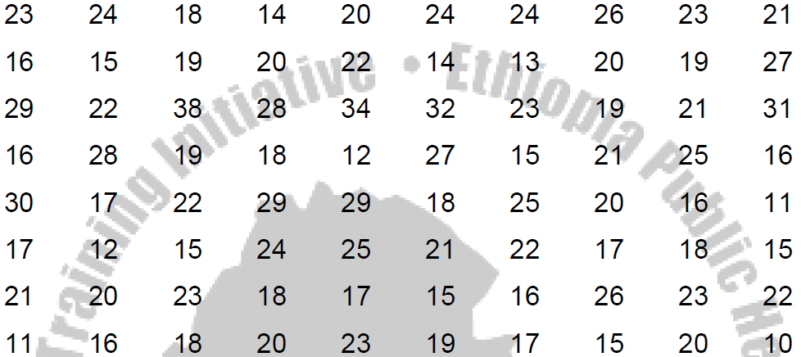
Example 2:
Construct a grouped frequency distribution of the following data on the amount of time (in hours) that 80 college students devoted to leisure activities during a typical school week:

Slide 62
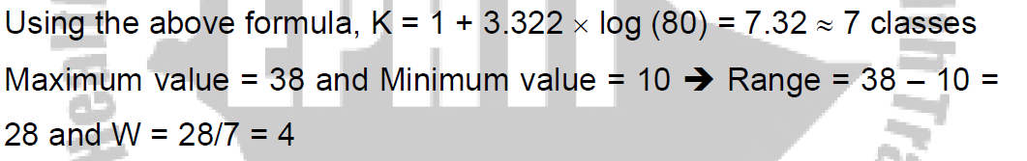
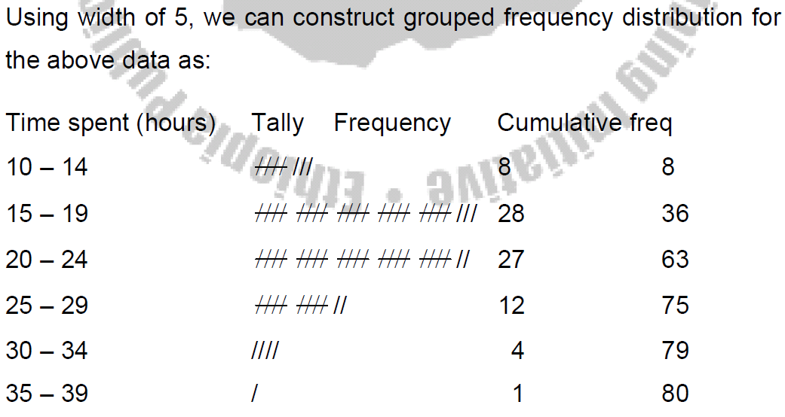

Slide 63
Diagrammatic and graphical Representation of Data

Slide 64
Introduction
Appropriately drawn graph allows readers to obtain rapidly an overall grasp of the data presented.
The relationship between numbers of various magnitudes can usually be seen more quickly and easily from a graph than from a table.
Figures are not always interesting, and as their size and number increase they become confusing and uninteresting to such an extent that no one (unless he is specifically interested) would care to study them.

Slide 65
Importance of Diagrammatic Representation
They have greater attraction than mere figures. They give delight to the eye and add a spark of interest.
They help in deriving the required information in less time and without any mental strain.
They facilitate comparison.
They may reveal unsuspected patterns in a complex set of data and may suggest directions in which changes are occurring. This warns us to take an immediate action.
They have greater memorizing value than mere figures. This is so because the impression left by the diagram is of a lasting nature.

Slide 66
Limitations of Diagrammatic Representation
The technique of diagrammatic representation is made use only for purposes of comparison. It is not to be used when comparison is either not possible or is not necessary.
Diagrammatic representation is not an alternative to tabulation. It only strengthens the textual exposition of a subject, and cannot serve as a complete substitute for statistical data.
It can give only an approximate idea and as such where greater accuracy is needed diagrams will not be suitable.
They fail to bring to light small differences

Slide 67
Construction of graphs
The choice of the particular form among the different possibilities will depend on personal choices and/or the type of the data.
Bar charts and pie chart are commonly used for qualitative or quantitative discrete data.
Histograms, frequency polygons are used for quantitative continuous data.

Slide 68
There are, however, general rules that are commonly accepted about construction of graphs.
Every graph should be self-explanatory and as simple as possible.
Titles are usually placed below the graph and it should again question what ? Where? When? How classified?
Legends or keys should be used to differentiate variables if more than one is shown
The axes label should be placed to read from the left side and from the bottom.
The units in to which the scale is divided should be clearly indicated.
The numerical scale representing frequency must start at zero or a break in the line should be shown.

Slide 69
1. Bar Chart
Bar diagrams are used to represent and compare the frequency distribution of discrete variables and attributes or categorical series.
When we represent data using bar diagram, all the bars must have equal width and the distance between bars must be equal.

Slide 70
There are different types of bar diagrams, the most important ones are:
Simple bar chart:
It is a one-dimensional diagram in which the bar Represents the whole of the magnitude.
The height or length of each bar indicates the size (frequency) of the figure represented.

Slide 71
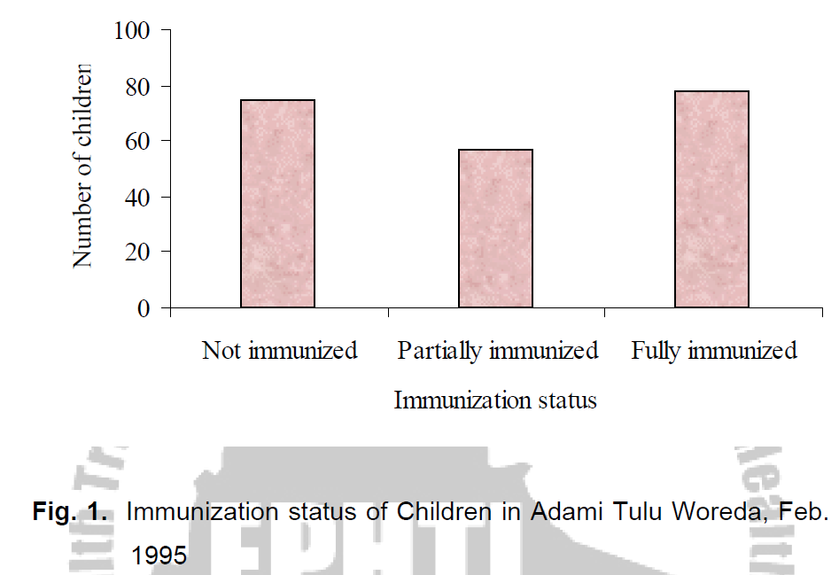

Slide 72
Bar Chart cont….
B. Multiple bar chart:
In this type of chart the component figures are shown as separate bars adjoining each other.
The height of each bar represents the actual value of the component figure.
It depicts distributional pattern of more than one variable

Slide 73
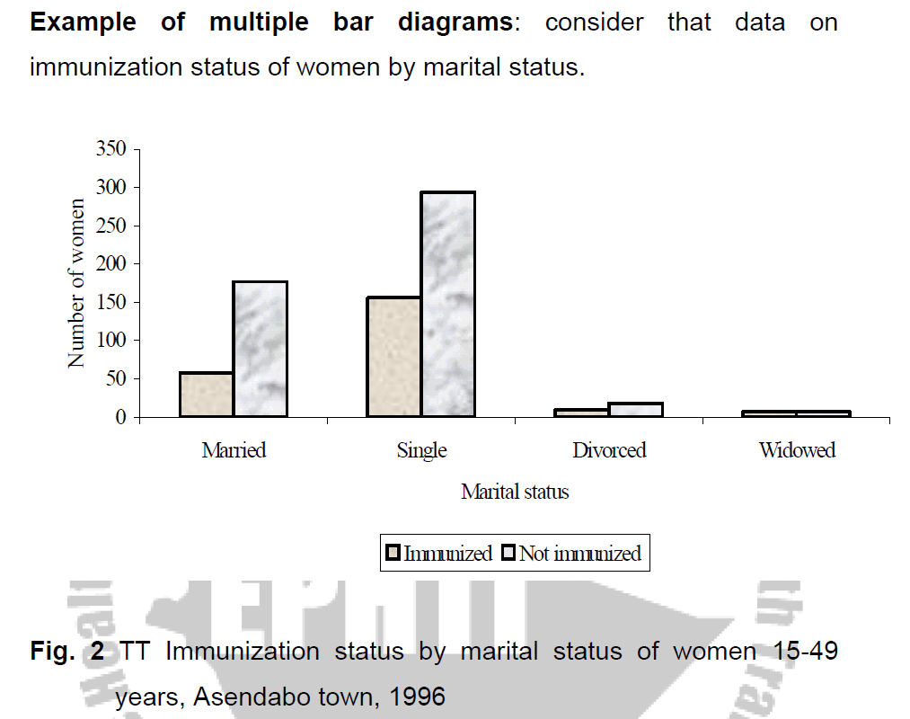

Slide 74
Bar Chart cont….
C. Component (or sub-divided) Bar Diagram:
Bars are sub-divided into component parts of the figure.
These sorts of diagrams are constructed when each total is built up from two or more component figures. They can be of two kind:
i) Actual Component Bar Diagram
ii) Percentage Component Bar Diagram

Slide 75
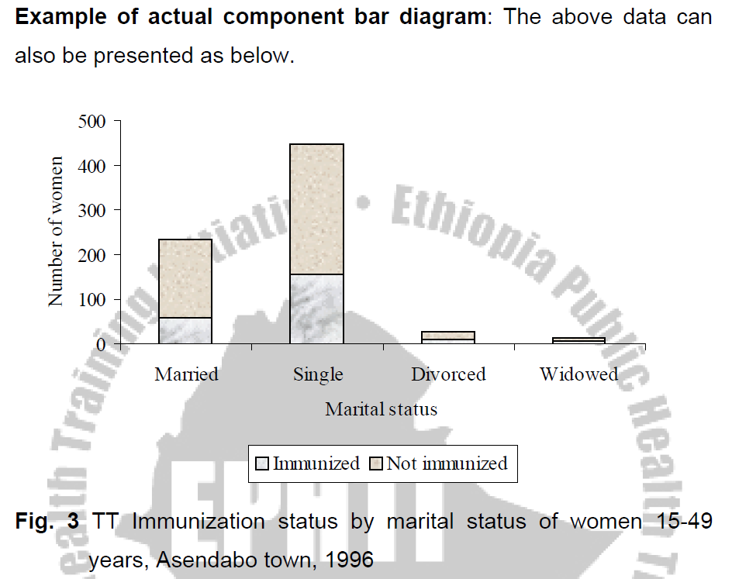
Actual Component Bar Diagrams:
When the over all height of the bars and the individual component lengths represent actual figures.

Slide 76
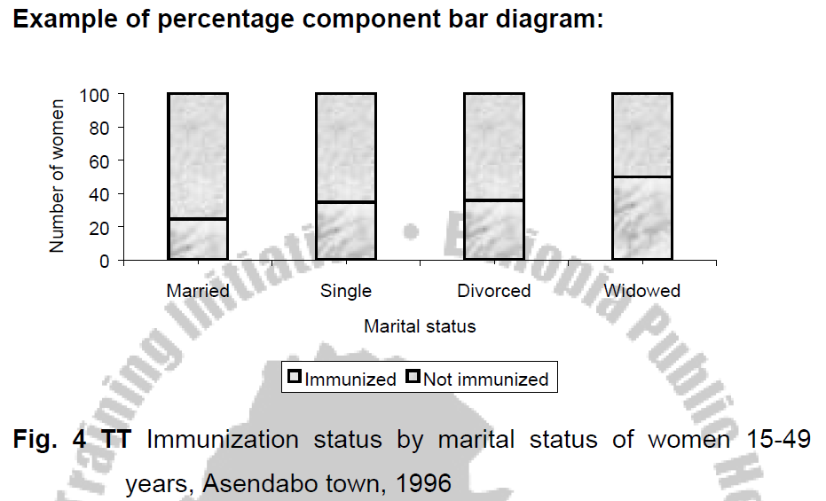
ii) Percentage Component Bar Diagram:
Where the individual component lengths represent the percentage each component forms the over all total. Note that a series of such bars will all be the same total height, i.e., 100 percent.

Slide 77
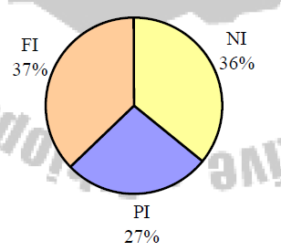
Pie-chart (qualitative or quantitative discrete data) It is a circle divided into sectors so that the areas of the sectors are proportional to the frequencies.
Fig. 5. Immunization status of children in Adami Tullu Woreda, Feb. 1995

Slide 78
Histograms (quantitative continuous data)
A histogram is the graph of the frequency distribution of continuous measurement variables.

Slide 79
It is constructed on the basis of the following principles:
The horizontal axis is a continuous scale running from one extreme end of the distribution to the other. It should be labelled with the name of the variable and the units of measurement.
For each class in the distribution a vertical rectangle is drawn with
Its base on the horizontal axis extending from one class boundary of the class to the other class boundary, there will never be any gap between the histogram rectangles.
The bases of all rectangles will be determined by the width of the class intervals. If a distribution with unequal class-interval is to be presented by means of a histogram, it is necessary to make adjustment for varying magnitudes of the class intervals.

Slide 80
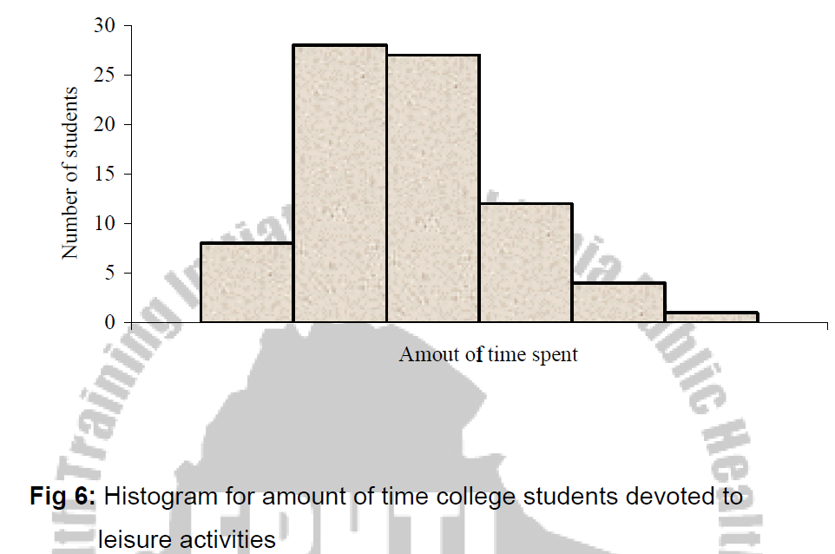
Example: Consider the data on time (in hours) that 80 college students devoted to leisure activities during a typical school week:

Slide 81
FREQUENCY POLYGON
If we join the midpoints of the tops of the adjacent rectangles of the histogram with line segments a frequency polygon is obtained.
When the polygon is continued to the X-axis just out side the range of the lengths the total area under the polygon will be equal to the total area under the histogram.
Note that it is not essential to draw histogram in order to obtain frequency polygon.

Slide 82
FREQUENCY POLYGON cont…
It can be drawn with out erecting rectangles of histogram as follows:
The scale should be marked in the numerical values of the midpoints of intervals.
Erect ordinates on the midpoints of the interval - the length or altitude of an ordinate representing the frequency of the class on whose mid-point it is erected.
Join the tops of the ordinates and extend the connecting lines to the scale of sizes.

Slide 83
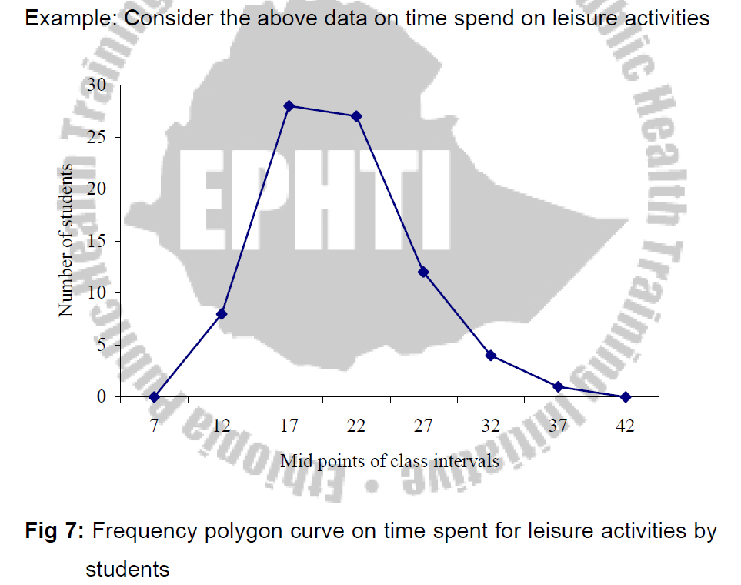

Slide 84
OGIVE OR CUMULATIVE FREQUENCY CURVE:
When the cumulative frequencies of a distribution are graphed the resulting curve is called Ogive Curve.
To construct an Ogive curve:
Compute the cumulative frequency of the distribution.
Prepare a graph with the cumulative frequency on the vertical axis and the true upper class limits (class boundaries) of the interval scaled along the X-axis (horizontal axis). The true lower limit of the lowest class interval with lowest scores is included in the X-axis scale; this is also the true upper limit of the next lower interval having a cumulative frequency of 0.

Slide 85
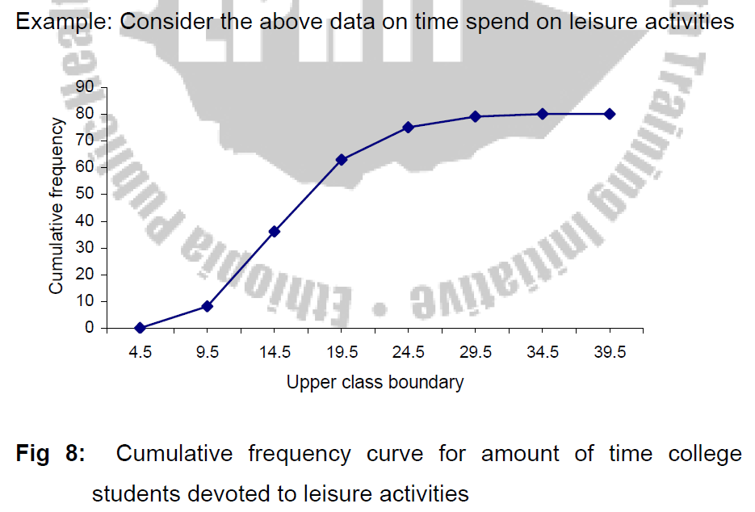

Slide 86
The line diagram
The line graph is especially useful for the study of some variables according to the passage of time.
The time, in weeks, months or years is marked along the horizontal axis; and the value of the quantity that is being studied is marked on the vertical axis.
The distance of each plotted point above the base-line indicates its numerical value. The line graph is suitable for depicting a consecutive trend of a series over a long period.

Slide 87
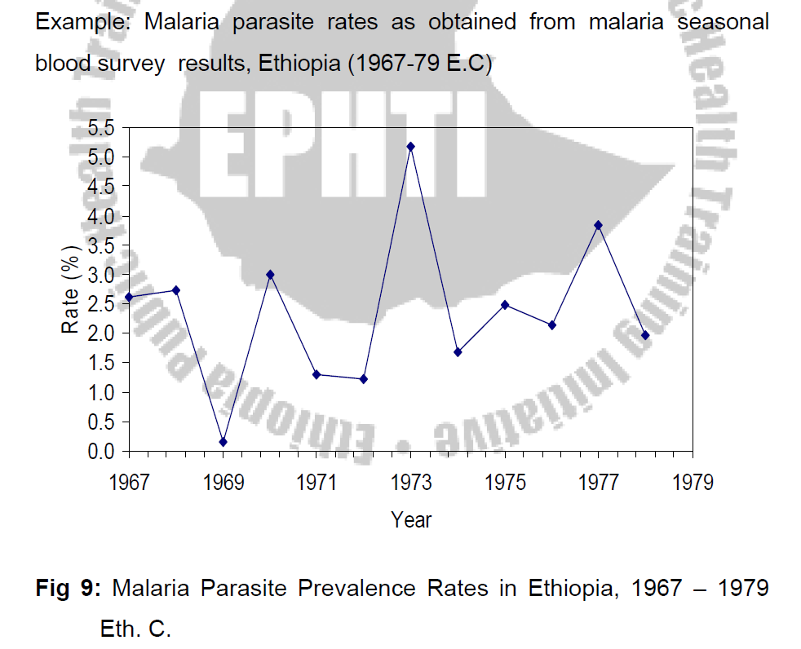

Slide 88
Methods of data summarization

Slide 89
Measures of Central Tendency
One type of measure useful for summarizing data defines the center or middle of the sample. This type of measure is a measure of central tendency (location).
Notations: Σ is read as Sigma (the Greek Capital letter for S) means the sum of.
Suppose n values of a variable are denoted as X₁, X₂ , X₃ …., X_{n} then ΣX_{i} = X₁,+X₂,+ X₃ +…X_{n} where the subscript i range from 1 up to n.

Slide 90
Introduction
Example:
Let X₁=2, X₂ = 5, X₃=1, X₄ =4, X₅=10, X₆= −5, X₇ = 8
Since there are 7 observations, i range from 1 up to 7
i) (Σx_{i})= 2+5+1+4+10-5+8 = 25
ii) (Σx_{i})² = (25)2 = 625
iii) Σx_{i}² = 4 + 25 + 1 + 16 + 100 + 25 + 64 = 235

Slide 91

1. Arithmetic Mean
One measure of central location for this sample is the arithmetic mean ; it is usually denoted by X̅ .
Definition:
The arithmetic mean is the sum of all observations divided by the number of observations. It is written in statistical terms as:

Slide 92
Example:
Suppose the sample consists of birth weights (in grams) of all live born infants born at a private hospital in a city, during a 1-week period.
2069, 2581, 2759, 2834, 2838, 2841, 3031, 3101, 3200, 3245, 3248, 3260, 3265, 3314, 3323, 3484, 3541, 3609, 3649, 4146
What is the arithmetic mean for the sample birth weights?

Slide 93




Solution
= =

Slide 94
The arithmetic mean is in general, a very natural measure of central location. One of its principal limitations, however, is that it is overly sensitive to extreme values.
It may not be representative of the location of the great majority of the sample points.
The arithmetic mean is a poor measure of central location in these types of sample, since it does not reflect the center of sample.
Nevertheless, the arithmetic mean is by far the most widely used measure of central location.

Slide 95
Characteristics of Mean
Uniqueness(for a given sets of data there is one and only one arithmetic mean).
Simplicity(The arithmetic mean is simple to understood and easy to compute).
It can only be used with quantitative data.
The mean will always exist, but it might not be an actual data value.

Slide 96
Characteristics of Mean cont….
Every data value has an effect on the mean, unlike the median and the mode.
It can be more sensitive to extreme data values than the median.
The sum of the deviations about it is zero.

Slide 97

Mean for a grouped data
This method is applicable where the entire range of available values or scores of the variable has been divided into equal or unequal class intervals and the observations have been grouped into a frequency distribution on that basis.
The value or score (x) of each observation is assumed to be identical with the mid-point (Xc) of the class interval to which it belongs.
In such cases the mean of the distribution is computed as:

Slide 98
Example
Time(Hours) | Frequency(A) | Mid point(B) | A*B
10-14 | 8 | 12 | 96
15-19 | 28 | 17 | 476
20-24 | 27 | 22 | 594
25-29 | 12 | 27 | 324
30-34 | 4 | 32 | 128
35-39 | 1 | 37 | 37
Total | 80 |  | 1655
Therefore; the mean will be
1655/80=20.7 hours

Slide 99
Median
An alternative measure of central location, perhaps second in popularity to the arithmetic mean, is the median.
The rational for these definitions is to ensure an equal number of sample points on both sides of the sample median.

Slide 100
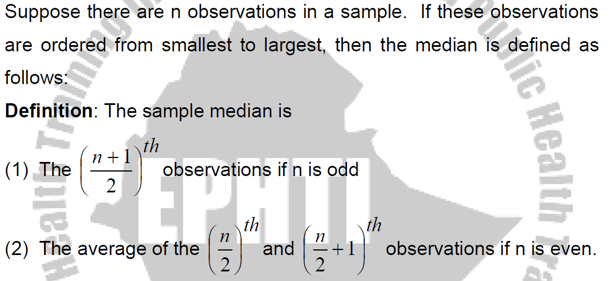

Slide 101
Median Cont…..
Example:
Compute the sample median for the birth weight data
First arrange in Ascending order
2069, 2581, 2759, 2834, 2838, 2841, 3031, 3101, 3200, 3245, 3248, 3260, 3265, 3314, 3323, 3484, 3541, 3609, 3649, 4146
Since n=20 is even,
Median = average of the 10th and 11th largest observation = (3245 + 3248)/2 = 3246.5 g

Slide 102
Median Cont…..
Example:
Consider the following data, which consists of white blood counts taken on admission of all patients entering a small hospital on a given day.
Compute the median white-blood count (×10³ ).
7, 35, 5, 9, 8, 3,10,12, 8
Median?????

Slide 103
Median Cont…
Solution:
First, order the sample as follows. 3, 5, 7, 8, 8, 9, 10,12, 35.
Since n is odd, the sample median is given by the 5th, (9+1)/2)^{th}, largest point, which is equal to 8.
The principal strength of the sample median is that it is insensitive to very large or very small values.
The principal weakness of the sample median is that it is determined mainly by the middle points in a sample and is less sensitive to the actual numerical values of the remaining data points.

Slide 104
Characteristics of Median
Uniqueness.
Simplicity.
It can only be used with quantitative data.
It is the center of the data set in that: at least half of the data value are greater than or equal to it, and at least half of the data value are less than or equal to it.
It can be less sensitive to extreme data values than the mean.

Slide 105
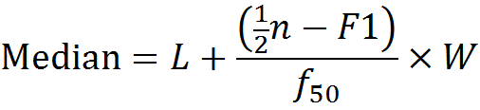



Median in a Grouped data
In the calculation of the median from a grouped frequency table, the basic assumption is that within each class of the frequency distribution, observations are uniformly or evenly distributed over the class interval.
It will be calculated as:-
Where
L= True lower limit of interval containing the median(i.e. the median class
W= Length of the interval
N=Total frequency of the sample
= Cumulative frequency of all interval below L
=Number of observations to be counted off from one end of the distribution to reach the median
=Frequency of the interval containing the median

Slide 106
Example
Time(Hrs) | Frequency(A) | Cumulative Frequency | Mid point(B) | AxB
10-14 | 8 | 8 | 12 | 96
15-19 | 28 | 36 | 17 | 476
20-24 | 27 | 63 | 22 | 594
25-29 | 12 | 75 | 27 | 324
30-34 | 4 | 79 | 32 | 128
35-39 | 1 | 80 | 37 | 37
Total | 80 |  |  | 1655
Median??????

Slide 107
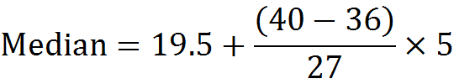
Solution
The Median class
= First class with (n/2)^{th} cumulative frequency
= The first class whose cumulative frequency is at least 40.
= The class whose CF at least 40 is the 3rd class(20-40)
LCB= 19.5
Frequency of the median= 27
CF next below the median class= 36
= 19.5+0.7
=20.2 hours

Slide 108
Mode
It is the value of the observation that occurs with the greatest frequency.
A particular disadvantage is that, with a small number of observations, there may be no mode.
In addition, sometimes, there may be more than one mode such as when dealing with a bimodal (two-peaks) distribution.

Slide 109
Find the modal values for the following data
22, 66, 69, 70, 73 (No modal value)
1.8, 3.0, 3.3, 2.8, 2.9, 3.6, 3.0, 1.9, 3.2, 3.5 (Modal value = 3.0 kg)

Slide 110
Characteristics of Mode
It can be used with quantitative and qualitative data.
The mode won’t always exist, but if it does, it must be an actual value of the data set.
It might not be located near the center of the data values.
It can be less sensitive to extreme data values than both the median and mean.

Slide 111
Measures of Variation
Some of the commonly used measures of dispersion (variation) are: Range, Interquartile Range, Variance, Standard deviation and Coefficient of variation.

Slide 112

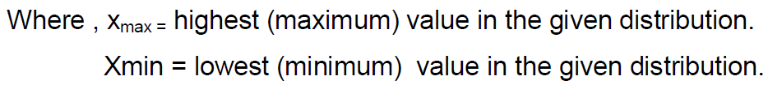
Range
The range is defined as the difference between the highest and smallest observation in the data.
It is the crudest measure of dispersion.
The range is a measure of absolute dispersion and as such cannot be usefully employed for comparing the variability of two distributions expressed in different units.

Slide 113
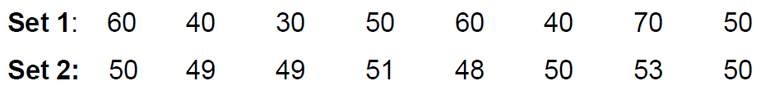
Example:
The range of data in set 1 is 70-30 =40
The range of data in set 2 is 53-48 =5

Slide 114
Characteristics of Range
Since it is based upon two extreme cases in the entire distribution, the range may be considerably changed if either of the extreme cases happens to drop out, while the removal of any other case would not affect it at all.
It wastes information for it takes no account of the entire data.
The extremes values may be unreliable; that is, they are the most likely to be faulty.
Not suitable with regard to the mathematical treatment required in driving the techniques of statistical inference.

Slide 115
Quantiles
Another approach that addresses some of the shortcomings of the range is in quantifying the spread in the data set is the use of quantiles or percentiles.
Intuitively, the P^{th} percentile is the value Vp such that p percent of the sample points are less than or equal to Vp.
The median, being the 50th percentile, is a special case of a quantile.
As was the case for the median, a different definition is needed for the P^{th} percentile, depending on whether np/100 is an integer or not.

Slide 116
Definition:
The p^{th} percentile is defined by
The (k+1)^{th} largest sample point if np/100 is not an integer (where k is the largest integer less than np/100)
The average of the (np/100)^{th} and (np/100 + 1)^{th} largest observation is np/100 is an integer.

Slide 117
Example:
Compute the 10th and 90th percentile for the birth weight data.
2069, 2581, 2759, 2834, 2838, 2841, 3031, 3101, 3200, 3245, 3248, 3260, 3265, 3314, 3323, 3484, 3541, 3609, 3649, 4146
Solution:
Since 20×0.1=2 and 20×0.9=18 are integers, the 10th and 90th percentiles are defined by
10th percentile = the average of the 2nd and 3rd largest values = (2581+2759)/2 = 2670 g
90th percentile=the average of the 18th and 19th largest values = (3609+3649)/2 = 3629 grams.
We would estimate that 80 percent of birth weights would fall between 2670 g and 3629 g, which gives us an overall feel for the spread of the distribution.

Slide 118
Other quantlies which are particularly useful are the quartiles of the distribution.
The quartiles divide the distribution into four equal parts.
The second quartile is the median.
The interquartile range is the difference between the first and the third quartiles.

Slide 119
To compute it, we first sort the data, in ascending order, then find the data values corresponding to the first quarter of the numbers (first quartile), and then the third quartile.
The interquartile range (IQR) is the distance (difference) between these quartiles.

Slide 120
Eg.
Given the following data set (age of patients):
18, 59, 24, 42, 21, 23, 24, 32
Find the interquartile range!
Sort the data from lowest to highest
Find the bottom and the top quarters of the data
Find the difference (interquartile range) between the two quartiles.

Slide 121
18 21 23 24 24 32 42 59
1st quartile = The {(n+1)/4}^{th} observation =(2.25)^{th} observation = 21 + (23-21)x .25 = 21.5
3rd quartile = {3/4 (n+1)}^{th} observation =(6.75)^{th} observation = 32 + (42-32)x .75 = 39.5
Hence, IQR = 39.5 - 21.5 = 18

Slide 122
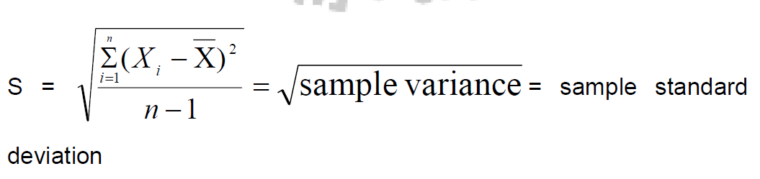
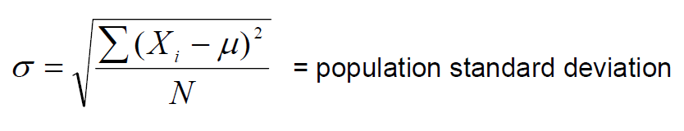
Standard Deviation and Variance
The sample and population standard deviations denoted by S and σ (by convention) respectively are defined as follows:

Slide 123
This measure of variation is universally used to show the scatter of the individual measurements around the mean of all the measurements in a given distribution.
Note that the sum of the deviations of the individual observations of a sample about the sample mean is always 0.

Slide 124
The square of the standard deviation is called the variance.
The variance is a very useful measure of variability because it uses the information provided by every observation in the sample and also it is very easy to handle mathematically.
Its main disadvantage is that the units of variance are the square of the units of the original observations.
The easiest way around this difficulty is to use the square root of the variance (i.e., standard deviation) as a measure of variability.

Slide 125
Example:
Areas of sprayable surfaces with DDT from a sample of 15 houses are as follows (m2) :
101,105,110,114,115,124,125, 125, 130, 133, 135, 136, 137, 140, 145
Find the variance and standard deviation of the above distribution.
The mean of the sample is 125 m² .

Slide 126
Variance (sample) = S² = Σ(xi –x)²/n-1
= (101-125)² + (105-125)²+ …. (145-125)²} / (15-1)
= 2502/14 = 178.71m²
Hence, the standard deviation = = 13.37m²

Slide 127
Coefficient of Variation
Definition:
The coefficient of variation (CV) is defined by: 100% Χ
The coefficient of variation is most useful in comparing the variability of several different samples each with different means.
This is because a higher variability is usually expected when the mean increases and the CV is a measure that accounts for this variability.

Slide 128
The coefficient of variation is also useful for comparing the reproducibility of different variables.
CV is a relative measure free from unit of measurement.
CV remains the same regardless of what units are used, because if the units are changed by a factor C, both the mean and SD change by the factor C; the CV, which is the ratio between them, remains uncharged.

Slide 129
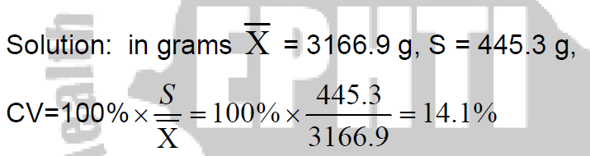
Example:
Compute the CV for the birth weight data when they are expressed in grams
2069, 2581, 2759, 2834, 2838, 2841, 3031, 3101, 3200, 3245, 3248, 3260, 3265, 3314, 3323, 3484, 3541, 3609, 3649, 4146

Slide 130
Reading assignment
Weighted mean of sample means and pooled standard deviation

Slide 131
Measures of shape of distribution
1. Skewness
Skewness is a measure of symmetry, or more precisely, the lack of symmetry.
A distribution, or data set, is symmetric if it looks the same to the left and right of the center point.
If extremely low or extremely high observations are present in a distribution, then the mean tends to shift towards those scores.

Slide 132
Skeweness cont…
Based on the type of skewness, distributions can be:
Negatively skewed distribution: occurs when majority of scores are at the right end of the curve and a few small scores are scattered at the left end.
Positively skewed distribution: Occurs when the majority of scores are at the left end of the curve and a few extreme large scores are scattered at the right end.
Symmetrical distribution: It is neither positively nor negatively skewed. A curve is symmetrical if one half of the curve is the mirror image of the other half.

Slide 133
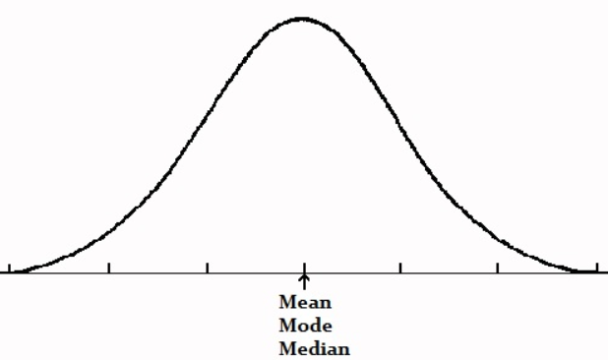
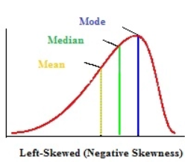
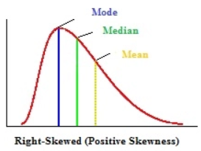
In unimodal (one-peak) symmetrical distributions, the mean, median and mode are identical.
The mean, median and mode occur in alphabetical order when the longer tail is at the left of the distribution.
Or in reverse alphabetical order when the longer tail is at the right of the distribution.

Slide 134
2. Kurtosis
measures the "tailedness" or sharpness of the peak of a distribution.
It indicates how much of the variance in the dataset is due to extreme values (outliers).

Slide 135
Kurtosis cont…
Types of Kurtosis:
Mesokurtic (Normal Kurtosis):
Kurtosis = 3. The distribution has a similar peak and tail behavior as the normal distribution.
Leptokurtic (High Kurtosis):
Kurtosis > 3. The distribution has a sharper peak and fatter tails, indicating more extreme values (outliers).
Example: Stock returns with occasional large jumps.
Platykurtic (Low Kurtosis):
Kurtosis < 3. The distribution has a flatter peak and thinner tails, indicating fewer extreme values.
Example: Uniformly distributed data.
Excess Kurtosis:
Excess kurtosis = Kurtosis - 3.
If excess kurtosis > 0: Leptokurtic (more extreme outliers).
If excess kurtosis < 0: Platykurtic (fewer extreme outliers).

Slide 136
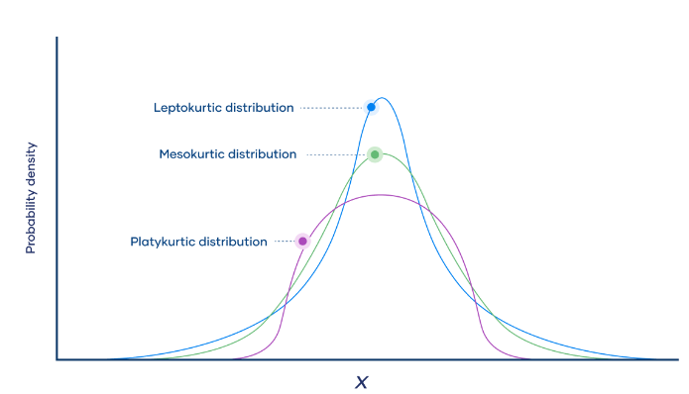

Slide 137
 | Mesokurtic | Platykurtic | Laptokurtic
Tailedness | Medium-tailed | Thin-tailed | Fat-tailed
Outlier frequency | Medium | Low | High
Kurtosis | Moderate (3) | Low (<3) | High (>3)
Excess kurtosis | 0 | Negative | Positive
Example distribution | Normal | Uniform | Laplace

Slide 138
Skeweness vs kurtosis
Measure | What it tells | Values
Skeweness | Asymmetry of data | Positive (>0) or Negative (<0)
Kurtosis | Tailedness of data | High (>3), Normal (3), Low (<3)

Slide 139
Data presentation, and summary measures using statistical software Practice session

Slide 140


